Slide 1
Lessons Learned from Canada’s Supervised Consumption (SCS) and Overdose Prevention Site (OPS) Service Providers Teleconference
Patrick McDougall,
Director of Knowledge Translation & Evaluation
Carly Welham,
Data Reporting & Evaluation Officer
Dr. Peter Centre
November 15, 2019
Notes:
My name is Patrick McDougall and I work at the Dr. Peter Centre in Vancouver.
I want to thank Kim Wilbur and the Symposium Committee for the invitation to speak today.
I also want to thank Cindy, Matt, [other names] for the excellent panel.
I’m going to be talking about Supervised Consumption Services, Supervised Injection Services, and Overdose Prevention Sites today.

Slide 2
Territorial acknowledgement

Slide 3
Welcome & Agenda
Background of the SCS/OPS Service Providers Teleconference
Evolution
Summary of key themes that emerged

Slide 4
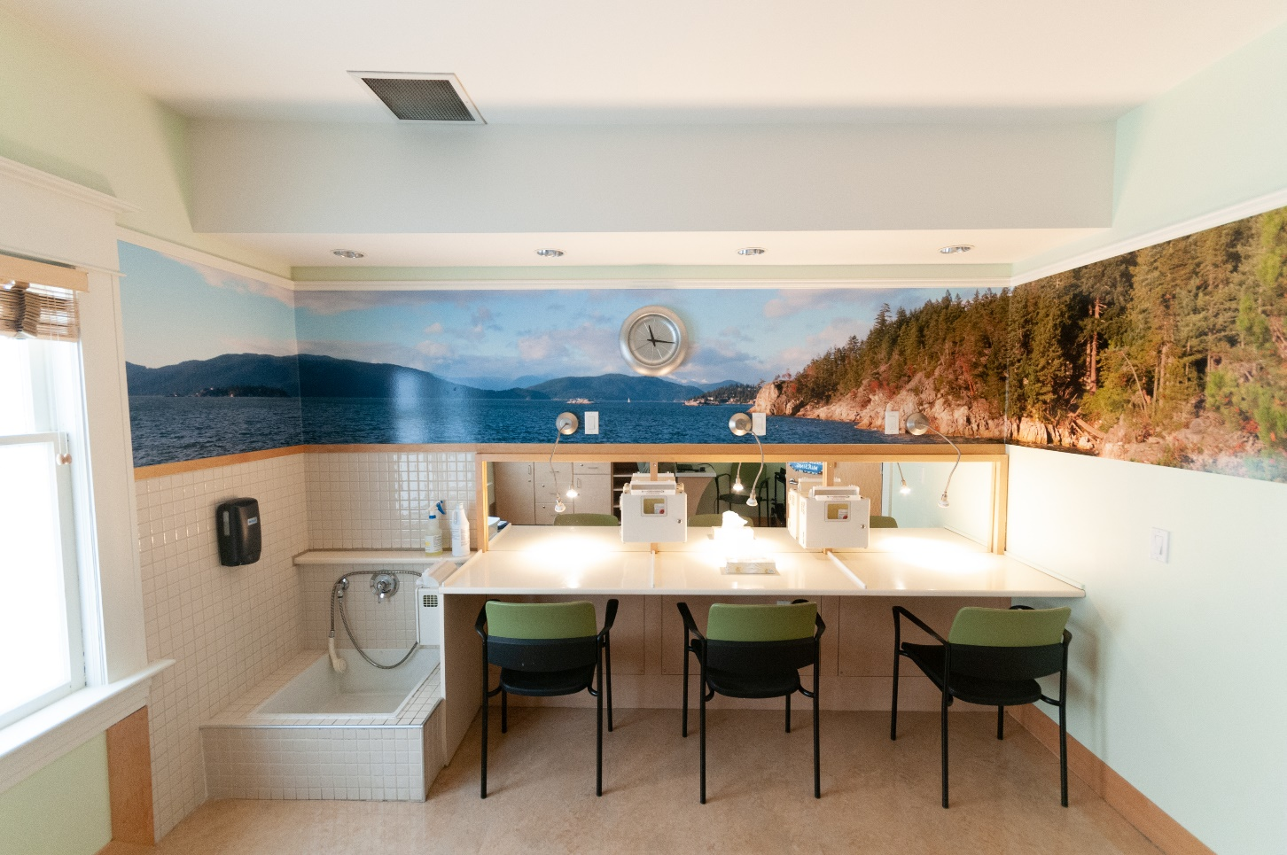
Dr. Peter Centre

Slide 5
Background
Public Health Agency of Canada funded project
Submitted in 2016
Started in 2017
Capacity building for 12 agencies starting supervised consumption services (SCS):
4 in year 1; 2 more each subsequent year
Started a bilingual teleconference in Sept 2017
Current and prospective SCS service providers starting with 14 people from Vancouver, Surrey, Montreal, and Toronto

Slide 6
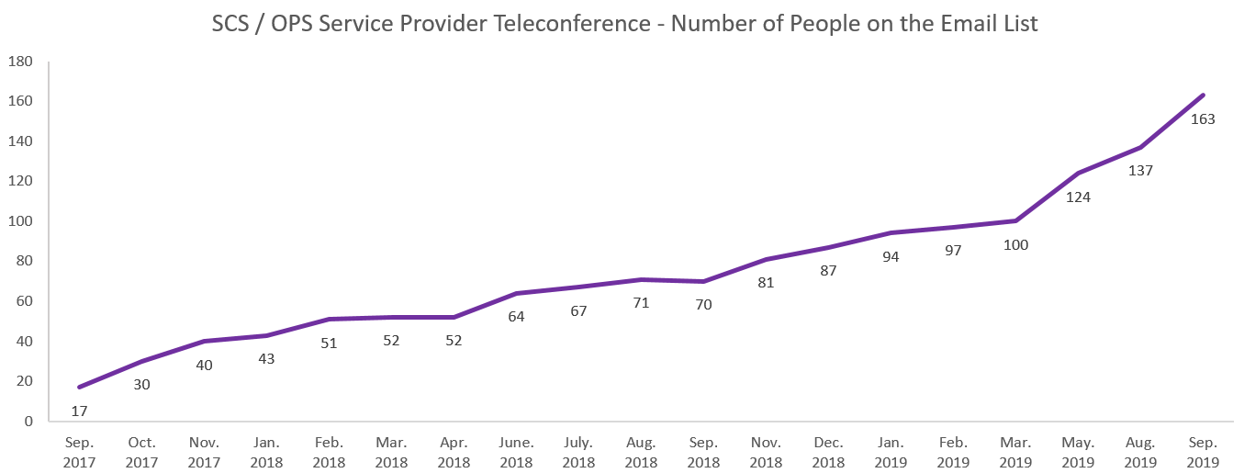
Growth in number of teleconference participants

Slide 7
Milestones Along the Way
Teleconference discussions begin to focus on specific topics
Many sites share the desire to offer additional services (e.g., peer assistance) and scale up those offered
Dedicated discussions on iOAT
Presentations on impact of peer assistance
Focused presentations on housing related topics (e.g., Housing Overdose Prevention Strategies, Brave Button)
Scaling up services
Community Engagement
Tailoring Discussion
Shift in Delivery
Teleconference Starts
2017
2018
2019
The first few teleconferences explore numerous topics related to service delivery in a broad manner
Re-enforcing the importance of community engagement as efforts from those opposed to SCS/OPS emerge
Decision made to move forward with targeted videocalls (supplemented by quarterly teleconferences)
Detailed presentation on washroom assessment and overdose prevention

Slide 8
Key Themes
Expanding Models
Operational Considerations
Navigating Regulatory Considerations
Community Engagement
Supporting Staff Resiliency

Slide 9
Expanding Models
Incorporating SCS/OPS in housing settings
Assisted injection
Inhalation services
Quality drug testing
24-hour services
Women-only and/or trans-only locations or hours
Allowances for splitting and sharing of drugs
Intravenous opioid agonist therapy (iOAT)
Access to low barrier safe supply
Decriminalization

Slide 10
Operational Considerations
Strategies to prevent wait times
Time limits
Policies for personal belongings
Clear signage
Consistent policies and procedures
People using outside facilities or in the washrooms
Complex overdoses

Slide 11
Navigating Regulatory Considerations
Dependence on political climate federally, provincially, municipally
Exemption Process
Regulations limiting:
Assisted injection
Splitting or sharing of drugs
Hiring of staff with a criminal record
Engaging other partners

Slide 12
Community Engagement
Community pushback has included:
Negative media
Court challenges
Needing to relocate
Service providers strategies have included:
Engaging stakeholders and the media
Hosting tours and engaging community consultations
Proactive measures (outreach workers)
Shortening wait times

Slide 13
Supporting Staff Resiliency
Processes to support wellbeing:
Debriefing
Education and workshops
Counselling
Capacity building opportunities:
Skill building and support
Peer employee networks
Job security

Slide 14
Acknowledgements
Thank you!
We would like to thank and acknowledge the contribution of everyone who has participated in the teleconference.
The teleconference has been made possible through a financial contribution from the Public Health Agency of Canada. The views expressed herein do not necessarily represent the views of the Public Health Agency of Canada.

